Slide 1
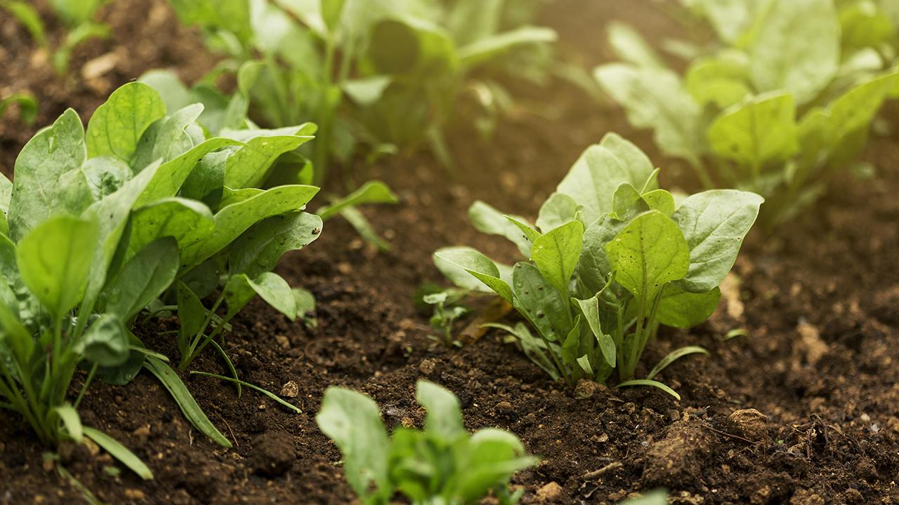
Integrated system for crop recommendation, fertilizers suggestion and plant disease detection

Slide 2
Project Guide: Mr T.Y.Srinivasa Rao
Project Members: 1.A.Santhosh Kumar –Y20ACS403 2.G.Harshitha -Y20AC445 3.B.Bhavana Sai –Y20ACS419 4.B.Ajay Kumar –Y20ACS414
Project Batch Name:A17

Slide 3
Abstract:
Precision agriculture is advancing rapidly, integrating machine learning and deep learning techniques to create a comprehensive system for crop recommendation, fertilizer suggestion, and plant disease detection. By leveraging data on crop attributes, soil characteristics, and environmental factors such as soil type, climate, rainfall, humidity, and temperature, as well as parameters like nitrogen, phosphorus, and potassium content in the soil, this system aims to optimize crop selection, recommend suitable fertilizers, and identify potential crop diseases. The ultimate goal is to enhance agricultural productivity and minimize crop losses through tailored solutions.

Slide 4
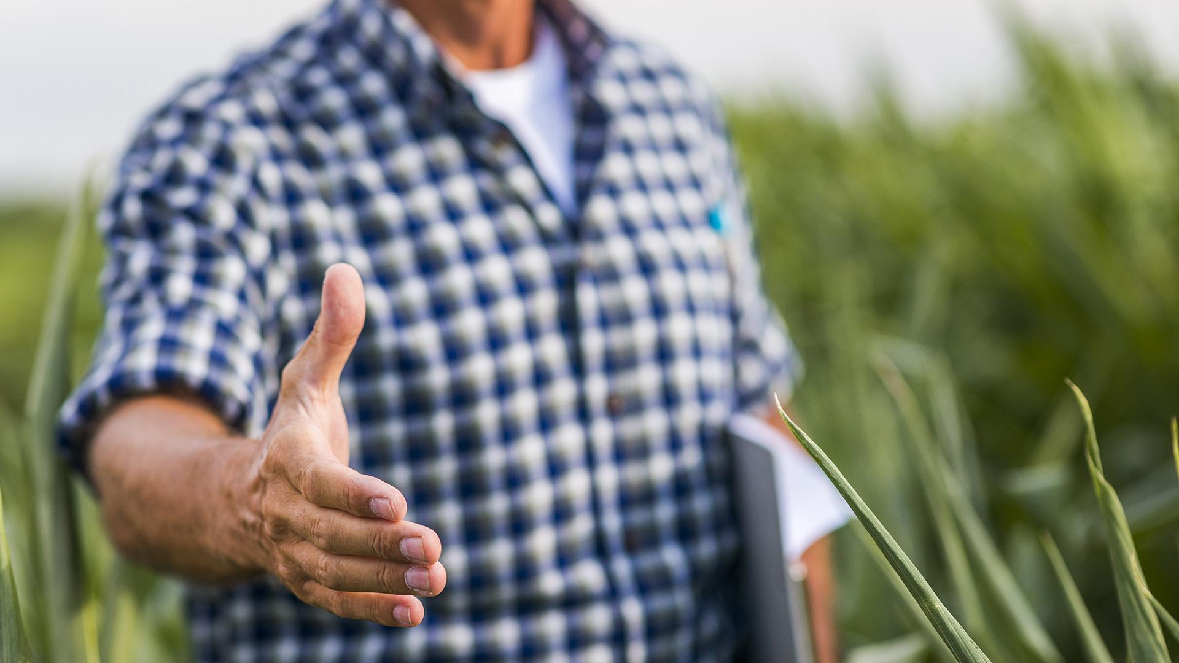
Introduction to Crop Recommendation
Crop recommendation utilizes data analysis and agricultural expertise to advise farmers on the best crops to grow based on local conditions, optimizing yields and sustainability. These systems help farmers make informed decisions, ultimately improving agricultural productivity and profitability.

Slide 5
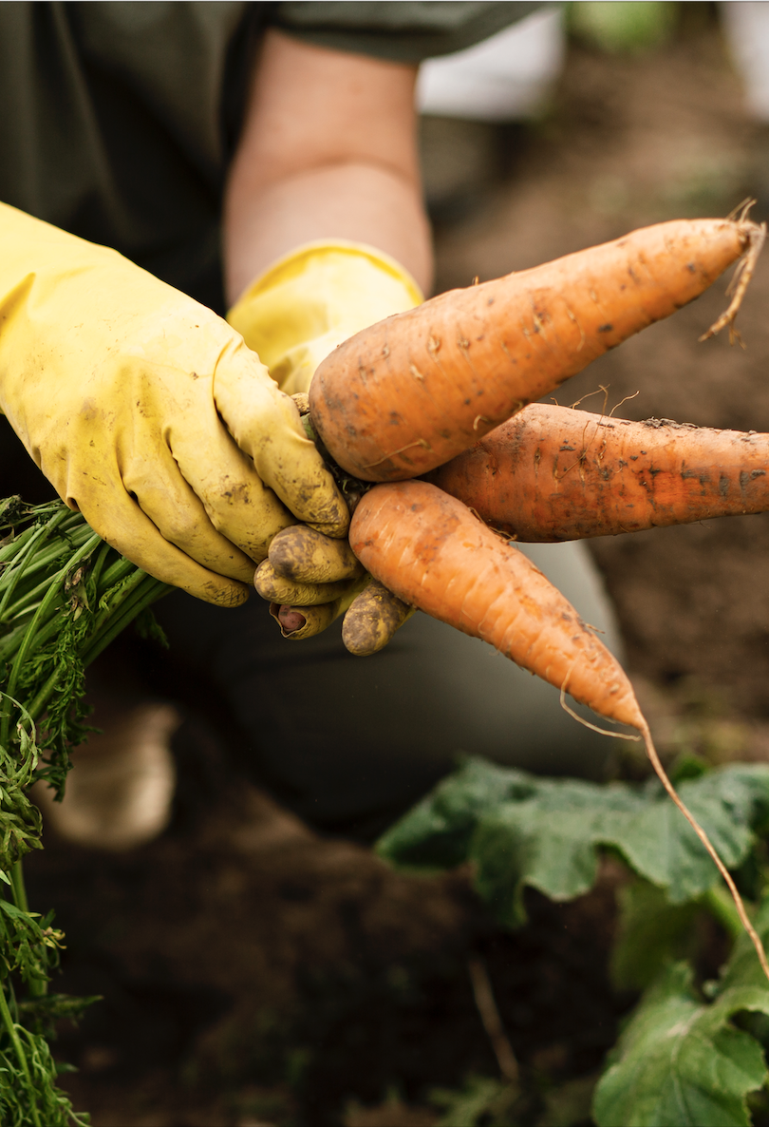
Introduction to Fertilizers Suggestion
Fertilizer suggestion, it's crucial to assess soil nutrient levels and crop requirements. A soil test can provide valuable insights into nutrient deficiencies, guiding the selection of the appropriate fertilizer blend. For instance, if the soil lacks nitrogen, a fertilizer with a higher nitrogen content would be recommended. Similarly, phosphorus and potassium deficiencies would necessitate fertilizers rich in these nutrients. Additionally, considering the crop's growth stage and environmental conditions can refine the fertilizer suggestion.

Slide 6
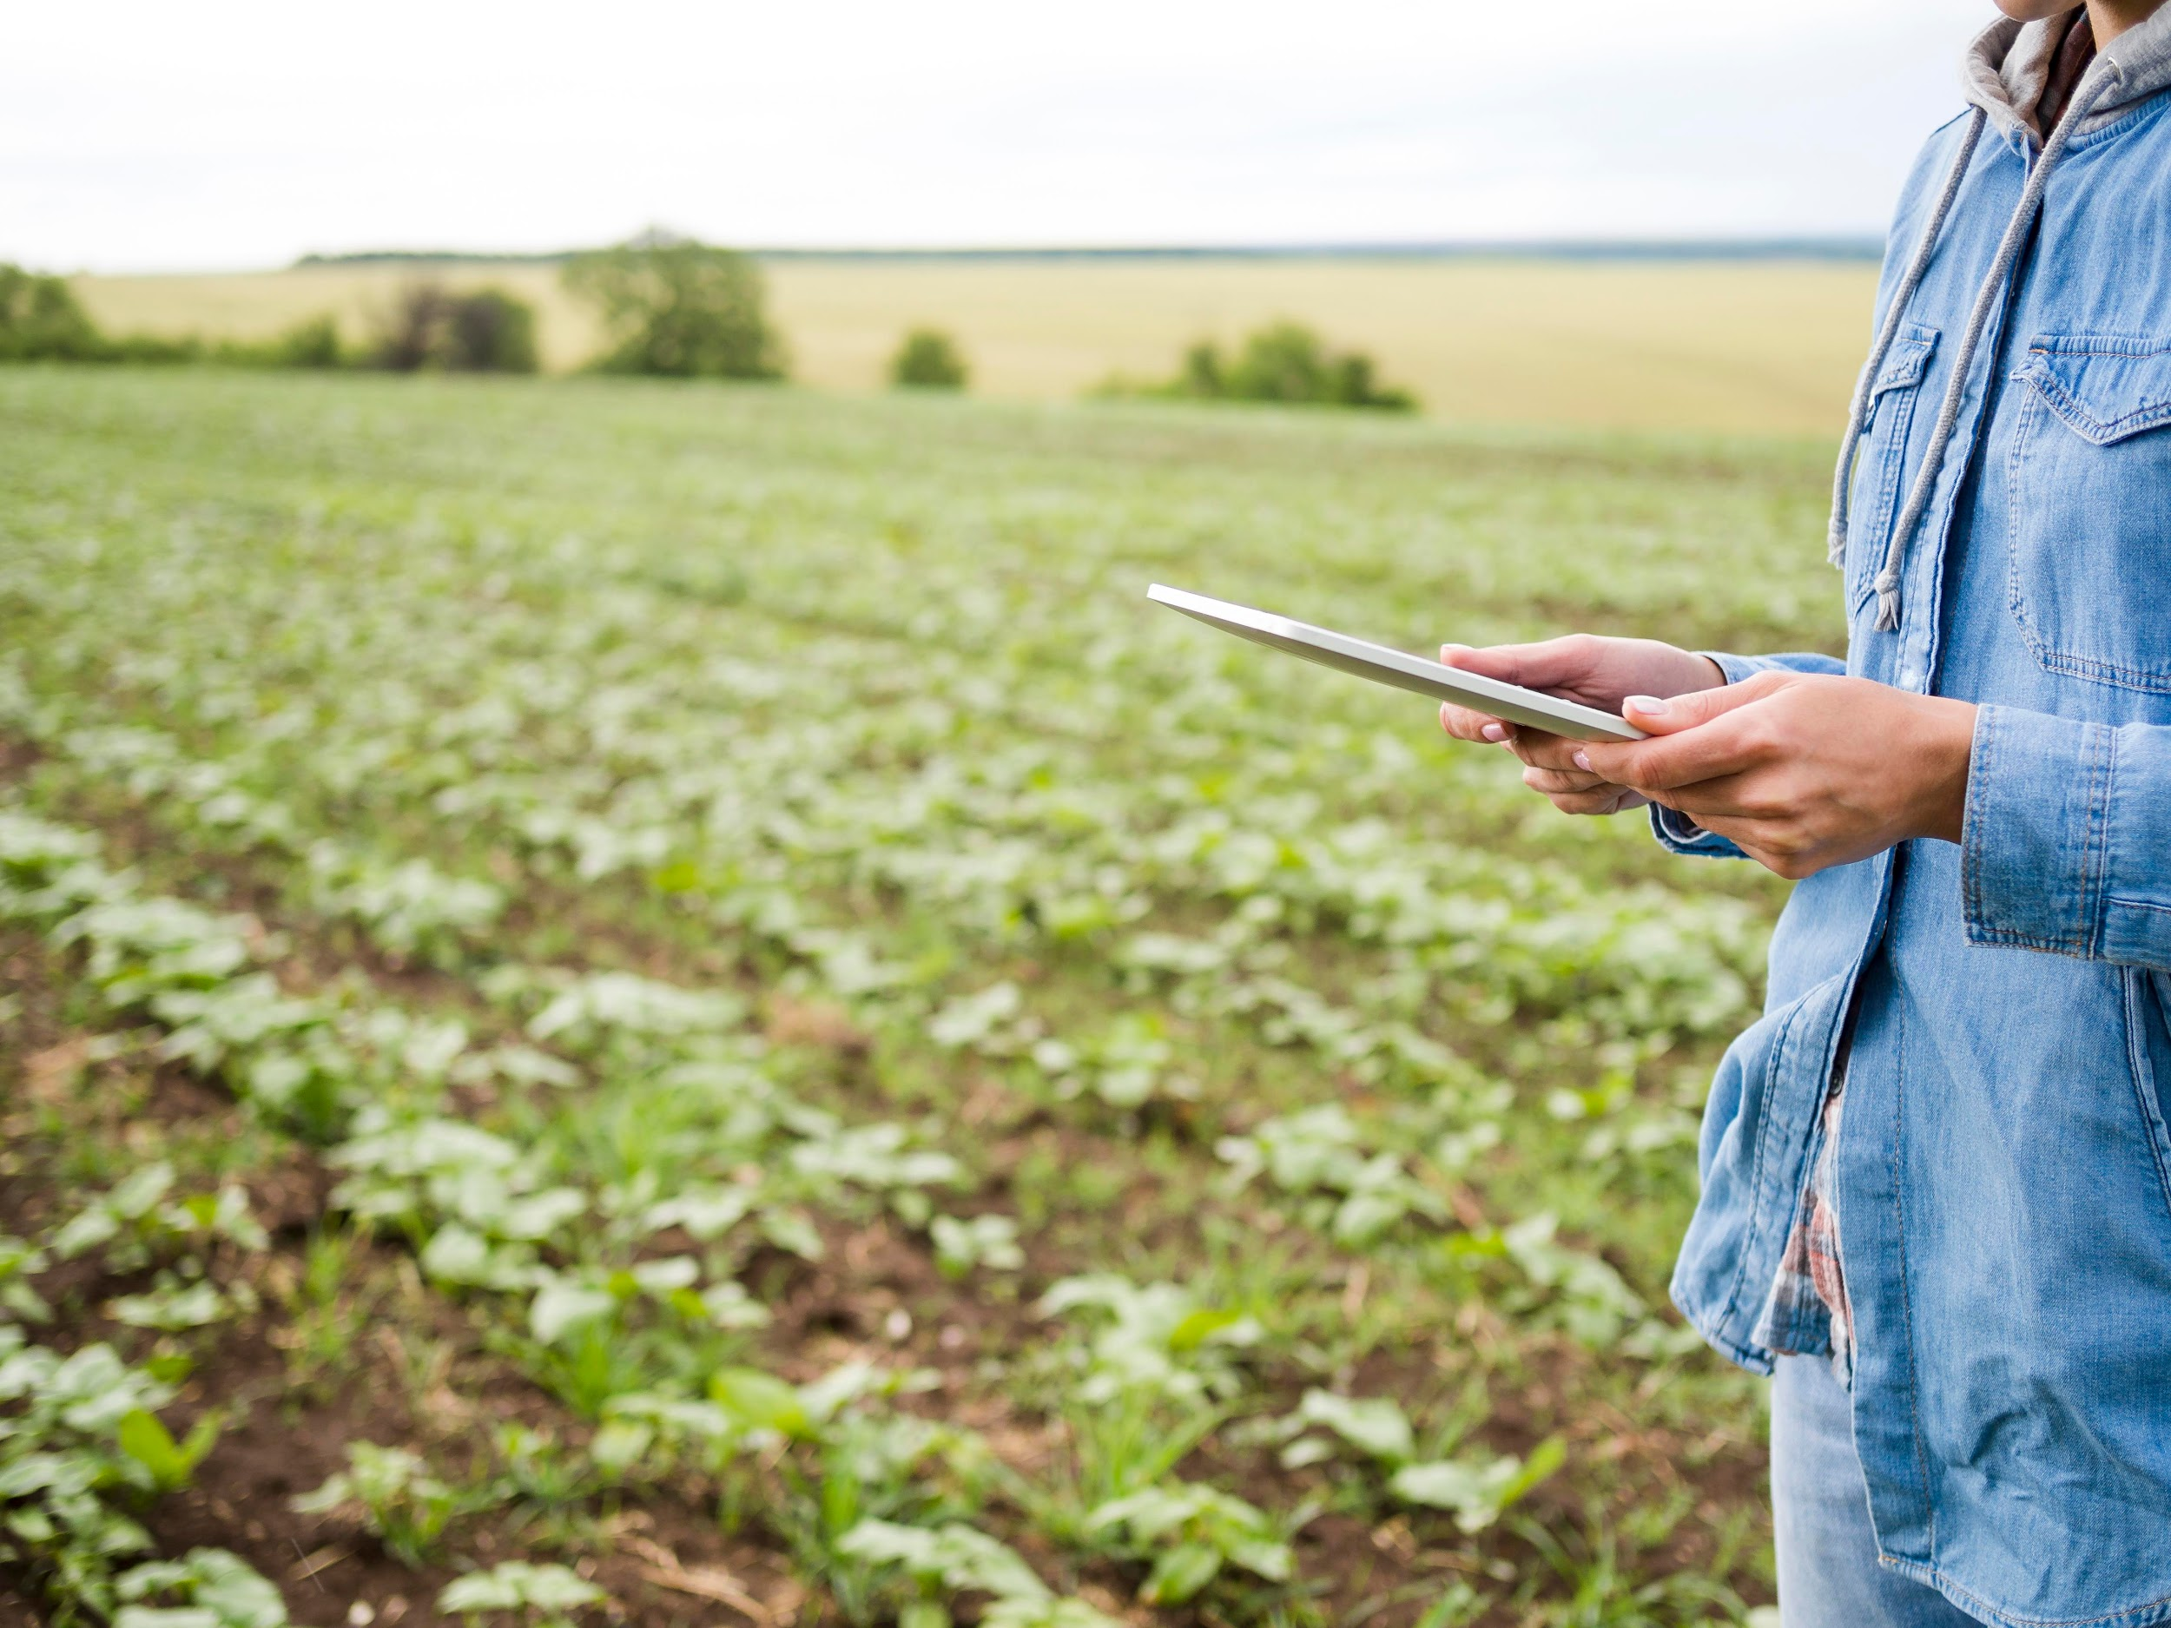
Introduction to Plant Disease Detection
Plants are essential for the environment, agriculture, and economy, but they are vulnerable to diseases caused by bacteria, fungi, and viruses, highlighting the critical need for timely detection and treatment, the Plant Disease Detector, utilizing deep learning to accurately identify plant diseases from leaf images, through Convolutional Neural Network (CNN) architecture trained on dataset. Disease detection in agricultural fields, facilitating prompt action to protect crop yields, ensure food security, and sustain the agricultural industry.

Slide 7
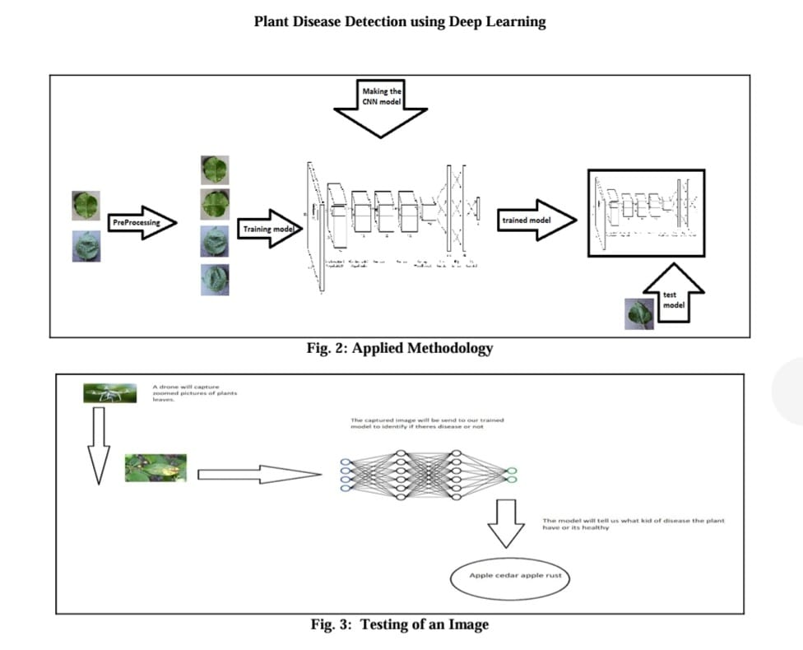

Slide 8
InttIroiduction
Scope
Integrated system for crop recommendation, fertilizer suggestion, and plant disease detection using machine learning and deep learning would primarily focus on its application within agricultural settings, including farms, plantations, and agricultural research institutions. This system aims to assist farmers and agricultural experts in making informed decisions regarding crop cultivation, soil management, and disease prevention to enhance productivity, Additionally, it may find utility in agricultural advisory services, educational institutions, and governmental agencies involved in agricultural development and support.

Slide 9
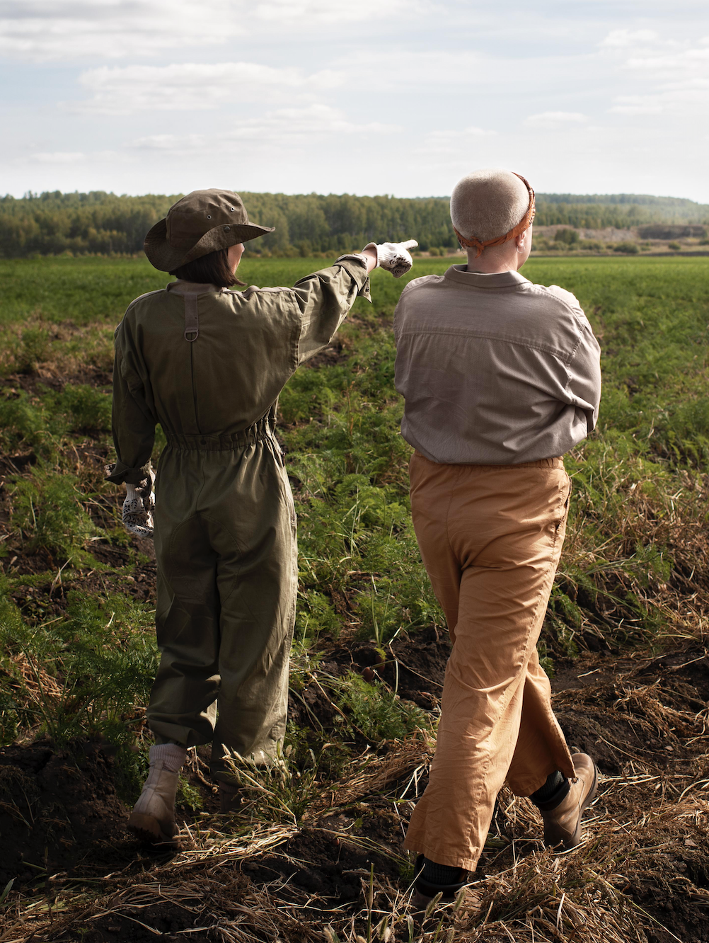
Problem Statement
In modern agriculture, farmers face numerous challenges related to crop selection, optimal nutrient management, and early detection of plant diseases. The integrated system aims to seamlessly combine crop recommendation, fertilizer suggestions, and plant disease detection capabilities into a single platform.

Slide 10
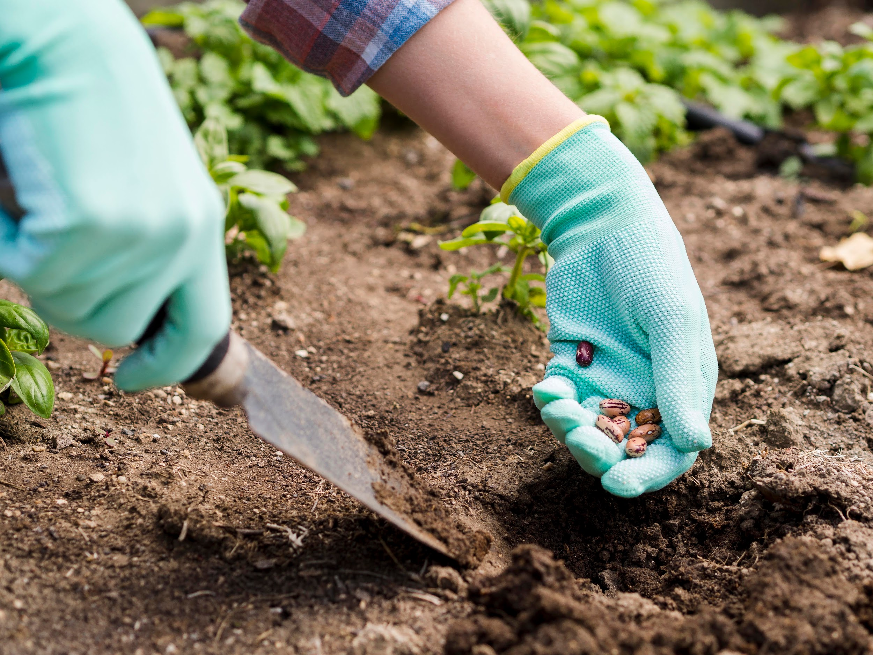
Existing Systems
Plantix
Plantix is a mobile application that offers plant disease detection and pest recognition services. It uses image recognition technology.
AgroCares Scanner
AgroCares Scanner is a handheld device that measures nutrient levels in soil samples and provides instant analysis through a mobile application.
Green IQ
An AI-powered platform that offers personalized recommendations for plant care, including watering schedules, fertilizer application, and pest management strategies.

Slide 11
Limitations of Existing Systems
Lack of Real-Time Updates
Limited Coverage of Plant Diseases
They are rely solely on these systems may miss identifying less common or emerging diseases that are not included in their databases.
While these systems aim to provide timely recommendations, they may not always offer real-time updates on disease outbreaks.

Slide 12

Proposed System
Our proposed system uses advanced computer techniques, like machine learning and deep learning, to assist farmers in managing their crops better. It provides guidance on which crops to grow, which fertilizers to use, and how to identify plant diseases. This platform helps farmers make smarter decisions and enhance their farming methods. By analyzing large amounts of data, it can offer accurate suggestions for crop management, fertilizer suggestion, and disease detection. we're constantly working to improve the accuracy of our system, ensuring it's even more helpful for farmers. Advantages
Improved crop choices
Early disease detection and control
Adaptation to changing weather patterns
Less waste and better resource management
Over all increased in crop yield

Slide 13
Applications
01.
03.
Soil Health Assessment
Soil Nutrient Analysis
02.
04.
Climate and Weather Forecasting
Integration with IoT Devices

Slide 14
Soil Health Assesment: The system evaluates soil parameters to determine its health, aiding in crop selection, fertilizer recommendations, and disease prevention.
Climate and Weather Forecasting: Utilizing weather data, it predicts climate patterns to optimize planting schedules, irrigation, and pest management strategies.
Soil Nutrient Analysis: By analyzing soil samples, it provides insights into nutrient levels, guiding precise fertilizer recommendations tailored to crop requirements.
Integration with loT Devices: Connects with loT sensors to gather real-time data on soil moisture, temperature, and crop health, enabling proactive decision-making and resource management.
References
This is aFood and Agriculture Organization. (2019). New Standards to Curb the Global Spread of Plant Pests and Diseases. Accessed: Nov. 8, 2022. [Online]. Available: https://www.fao.org/
Li, S. Zhang, and B. Wang, ‘‘Plant disease detection and classification by deep learning—A review,’’ IEEE Access, vol. 9, pp. 56683–56698, 2021.
https://chat.openai.com/c/8e39a8a6-69cf-41cc-b452-70394ca180ea.

Slide 15
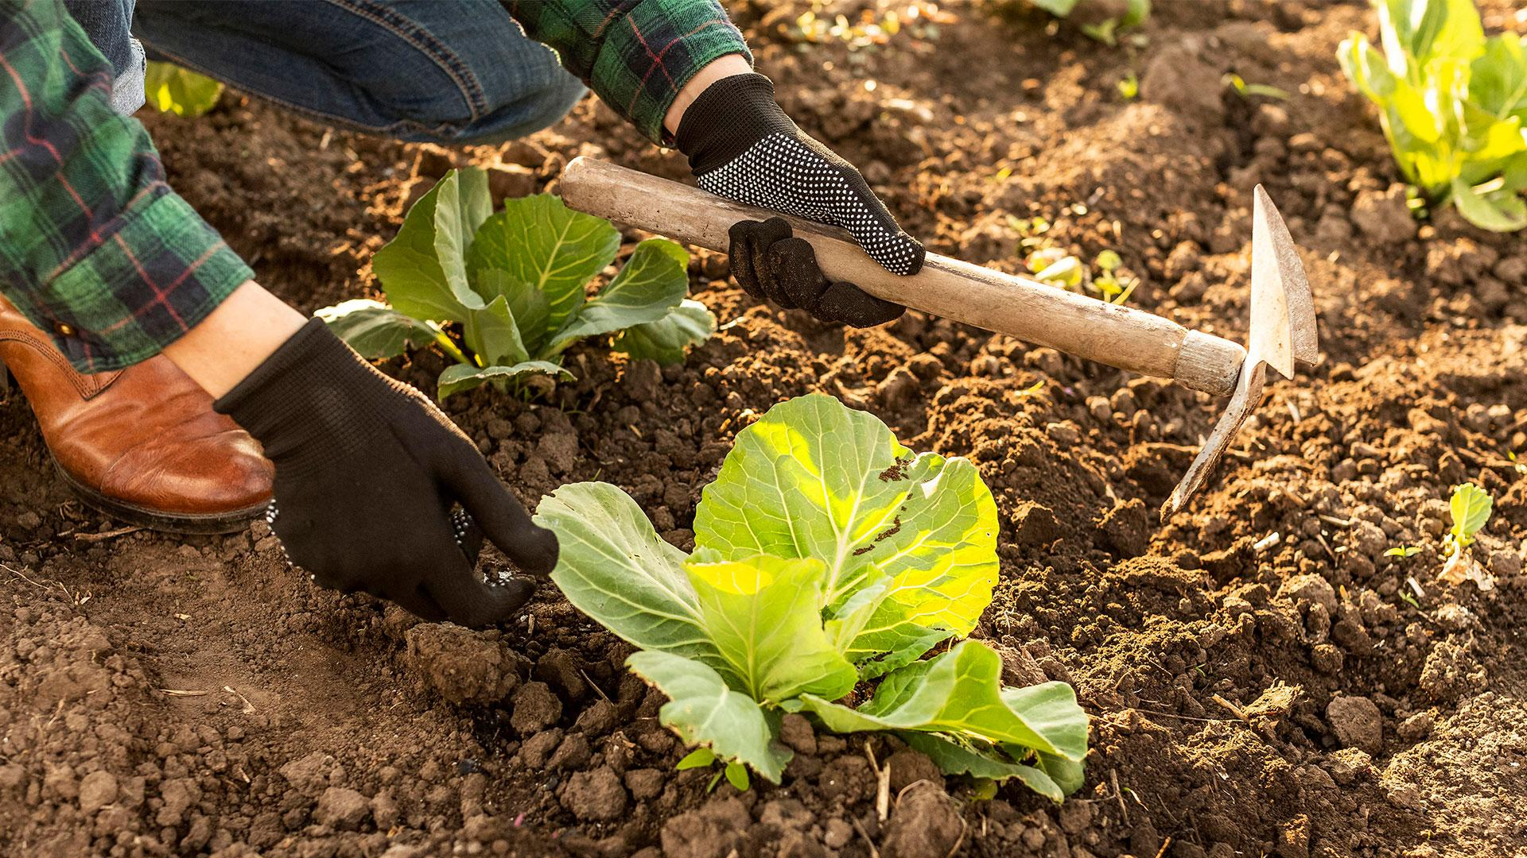
Thank You

